Slide 1
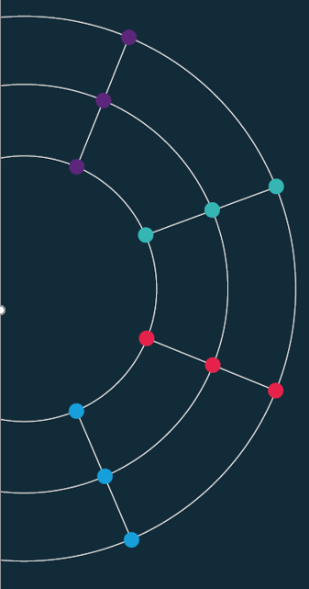
Session 4. Visualisation and advanced analytics
[90 min]

Slide 2
Session 4. Visualisation and advanced analytics
The grammar of graphics
[90 min]
[30 min]

Slide 3
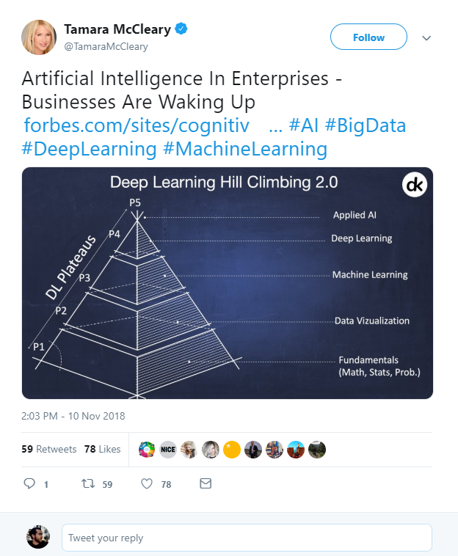

What is Data Science?
Artificial Intelligence?
Machine Learning?
Deep Learning?
Big Data?
https://twitter.com/TamaraMcCleary/status/1061197523610550272
Notes:
Tamara MCcleary – Tech Influencer
The data science pyramid
What do some of the more “fashionable” terms mean?
https://twitter.com/TamaraMcCleary/status/1061197523610550272

Slide 4

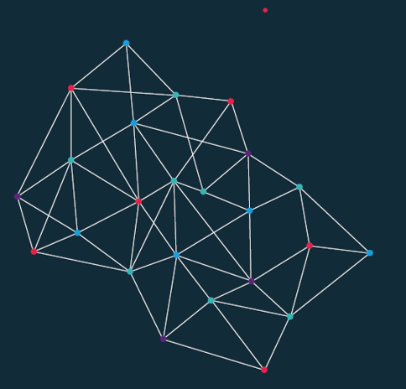
1 ZB zeta-exa-peta terra-giga-mega
Norhteastern, 2016
Notes:
In one year, humanity generates around 1ZB of data.
www.northeastern.edu/graduate/blog/how-much-data-produced-every-day/
If you take an average 10GB phone, that means 100 billion of phones.
If you take these phones and you stack them, screen to back, you could build one million 800m tall towers.
That is one Burj Khalifa for every pixel on this screen.

Slide 5
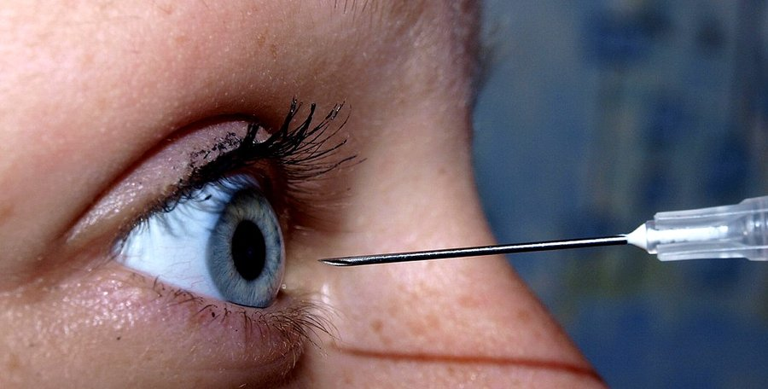
Attention ? At tension ?
Notes:
Data is practically infinite. But is your attention, too?

Slide 6

250 ms
Sabine Kastner et al., Princeton, 2018
Notes:
Sabine Kastner et al., Princeton, 2018
Your brain effectively has quarter of a second to decide what is important and what is not.

Slide 7

Attention poverty
"What information consumes is rather obvious: it consumes the attention of its recipients. Hence, a wealth of information creates a poverty of attention, and a need to allocate that attention efficiently among the overabundance of information sources that might consume it."
Herb Simon, as quoted by Hal Varian, Scientific American, 1995. Adapted from UW CSE442 and the original research by PARC UIR
Notes:
There is an overload of information.
We need a way to figure out what is important and what is not.

Slide 8
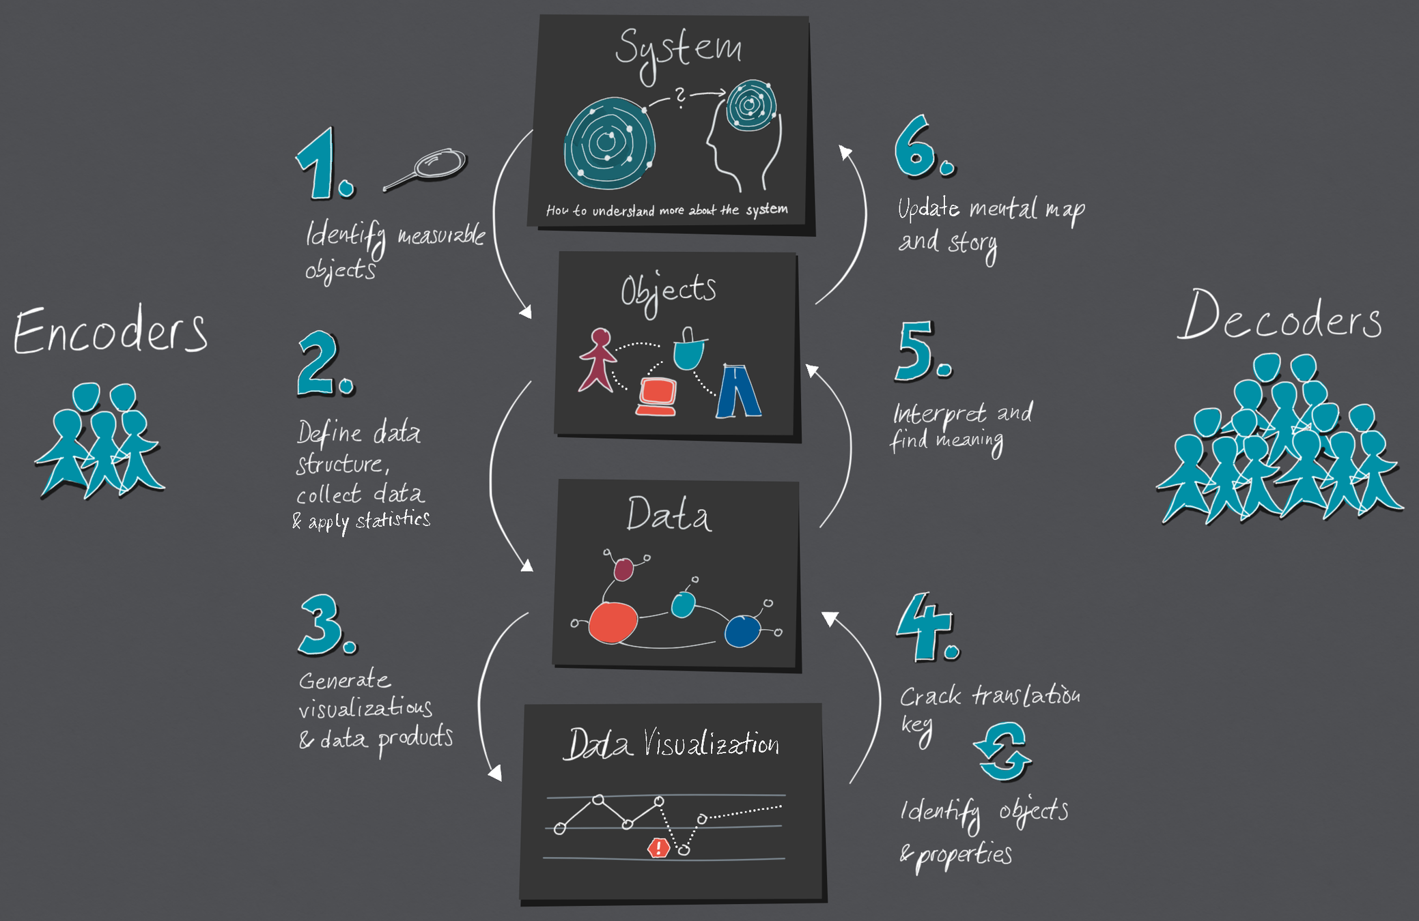

https://medium.com/nightingale/the-cycle-of-encoding-and-decoding-f3ff17010631
Notes:
Data visualisation is a language of conversing with data.
https://medium.com/nightingale/the-cycle-of-encoding-and-decoding-f3ff17010631

Slide 9

Big Data. Big Responsibility.
The Datasaurus, Autodesk, Alberto Cairo, 2017
Notes:
So there is too much data, but our attention is limited.
The art is then to extract what is important from that huge pile of data.
Welcome to Data Science.

Slide 10

Visual language is a sign system.
Images perceived as a set of signs.
Sender encodes information in signs.
Receiver decodes information from signs.
In his foreword to the 1983 English translation Howard Wainer called Bertin's work, the most important work on graphics since the publication of Playfair's Atlas
Jacques Bertin, Semiologie Graphique, 1967

Slide 11
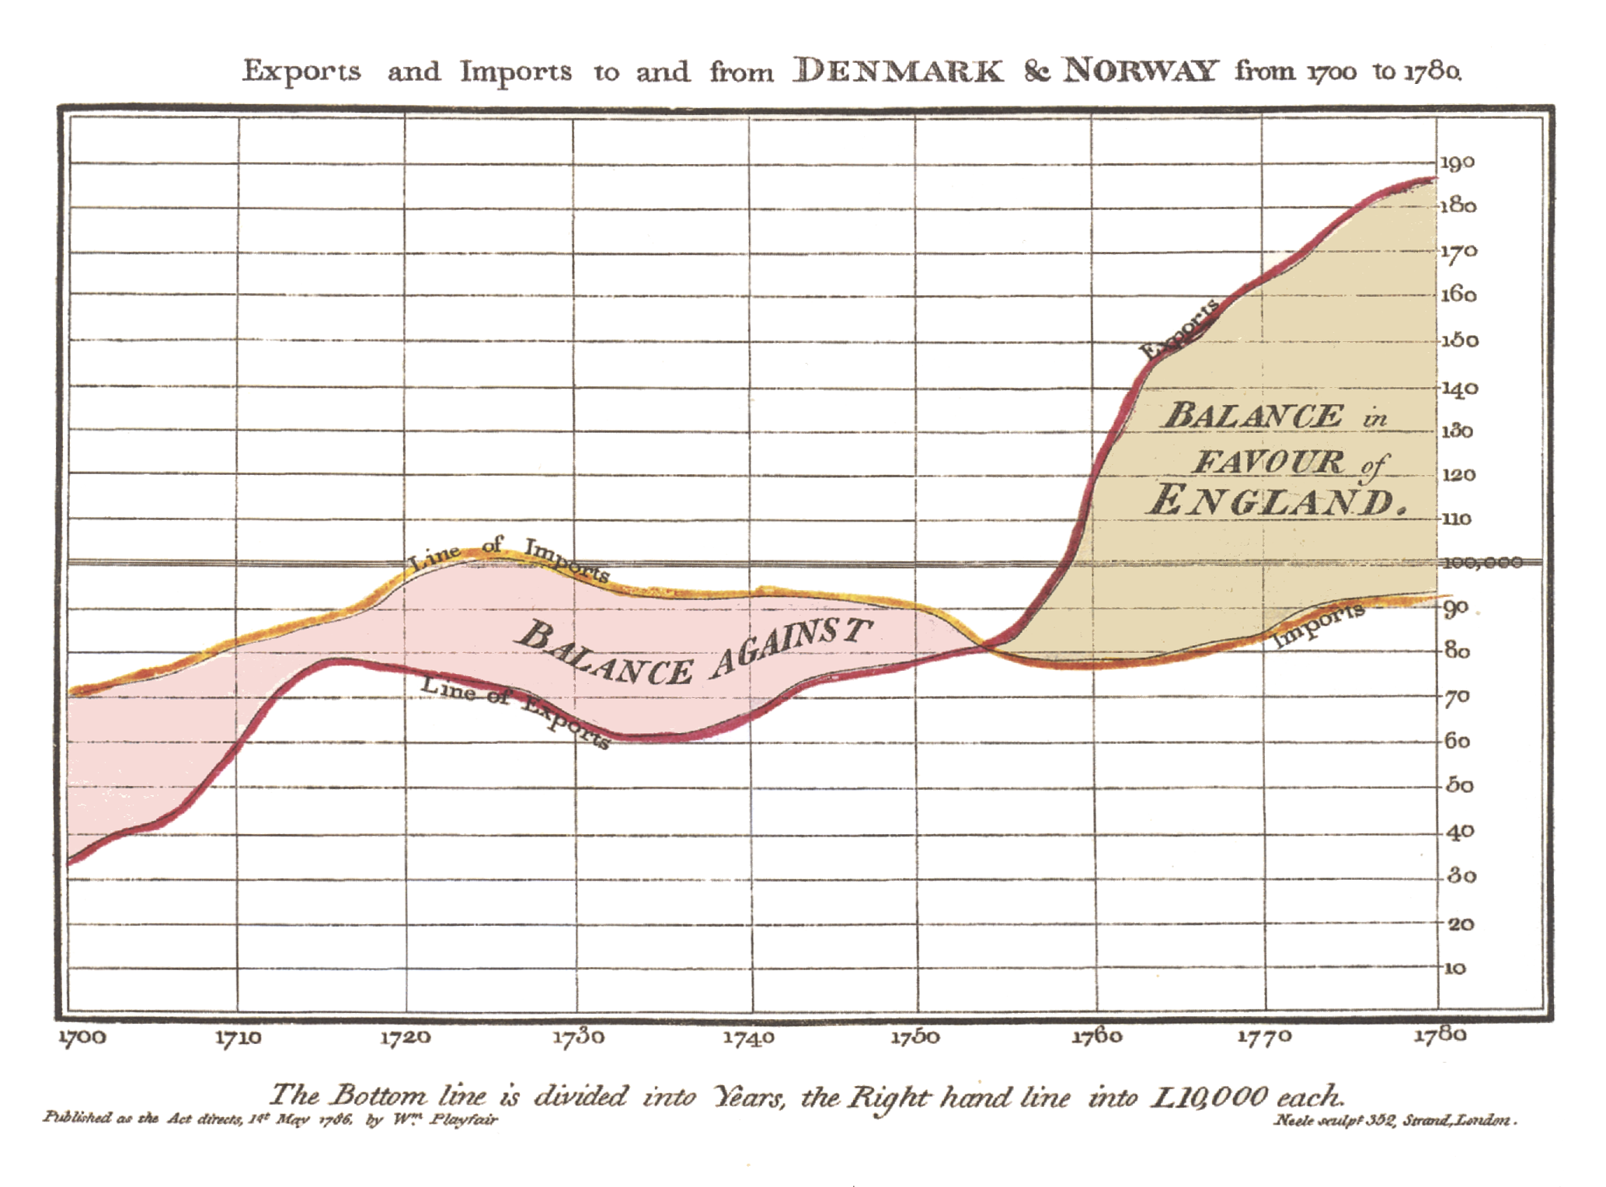
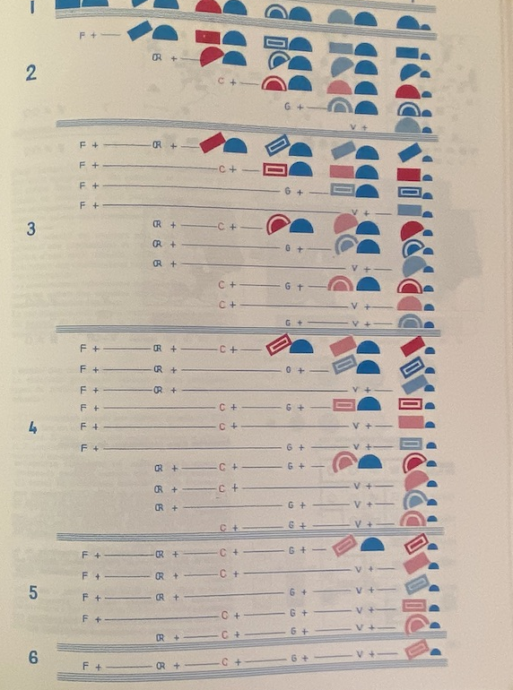
Visual language is a sign system.
William Playfair, The Commerical and Political Atlas, 1785 and Jacques Bertin, Semiologie Graphique, 1967
both collected from Jemery Norman’s HistoryOfIformation.com, 2021
Notes:
https://www.historyofinformation.com/detail.php?entryid=2929
https://www.historyofinformation.com/detail.php?id=3361

Slide 12
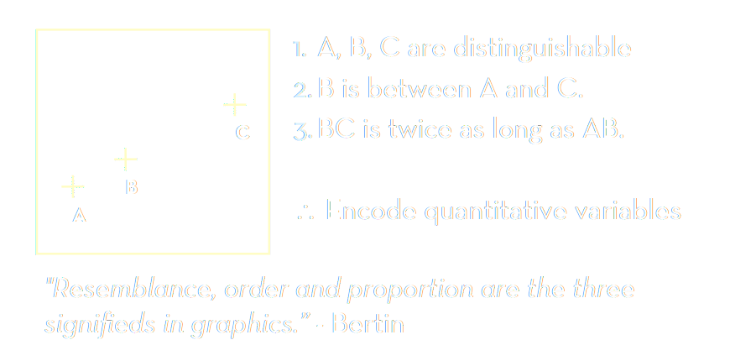
Bertin’s semiology of graphics.
Adapted from Jeffrey Heer, 2018, UW CSE442, after Jacques Bertin, Semiologie Graphique, 1967
Notes:
https://www.historyofinformation.com/detail.php?entryid=2929
https://www.historyofinformation.com/detail.php?id=3361

Slide 13
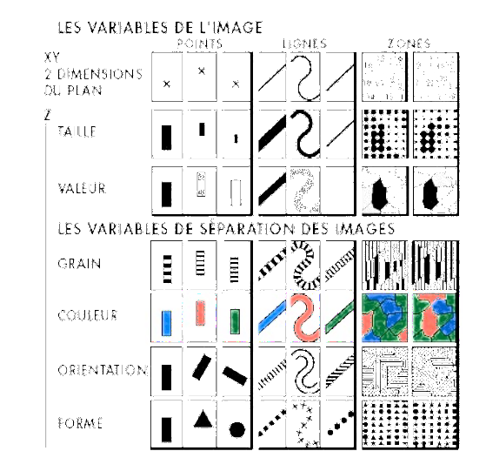
Visual encoding variables. Visual Grammar.
Position (x2)
Size
Value (Saturation)
Texture
Colour
Orientation
Shape
(Time/Animation, Focus, Opacity)
Adapted from Jeffrey Heer, 2018, UW CSE442, after Jacques Bertin, Semiologie Graphique, 1967
Notes:
https://www.historyofinformation.com/detail.php?entryid=2929
https://www.historyofinformation.com/detail.php?id=3361

Slide 14
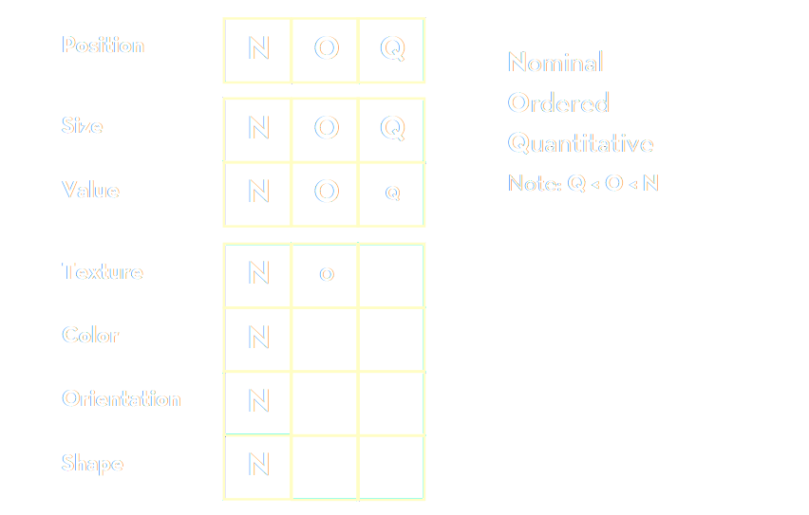
Bertin’s “Levels of Organisation”
Bertin’s list: based on theoretical considerations of semiology
Adapted from Jeffrey Heer, 2018, UW CSE442, after Jacques Bertin, Semiologie Graphique, 1967
Notes:
Bertin’s list – based on theoretical considerations of semiology

Slide 15
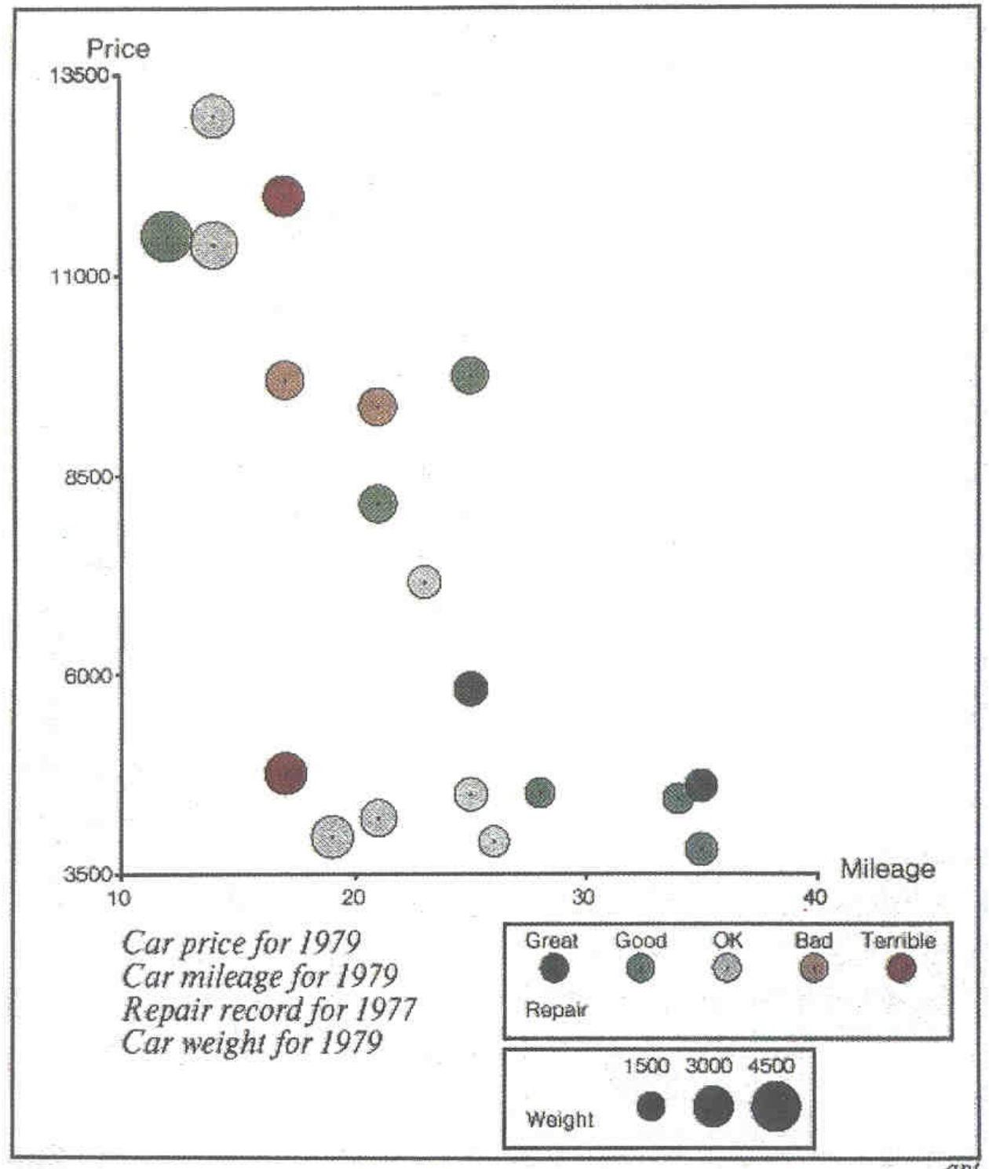
Mackinlay design criteria.
Formalizes Bertin for machines.
Expresiveness A set of facts is expressible in a visual language if the sentences (i.e. the visualisations) express all the facts in the set of data, and only the facts.
Effectiveness A visualisation is more effective than another if the information conveyed by one visualisation is more readily perceived than the information in the other visualization.
Adapted from Jeffrey Heer, 2018, UW CSE442 and Jock Mackinlay’s presentation at Ohio State University, 2005,
both based on Jock Mackinlay, Tableau/Xerox PARC/Stanford 1986
Notes:
http://web.cse.ohio-state.edu/~machiraju.1/teaching/CSE5544/mackinlay_midterm_material.pdf
Vice President of Visual Analysis at Tableau
https://www.tableau.com/learn/whitepapers/data-storytelling-using-visualization-share-human-impact-numbers

Slide 16
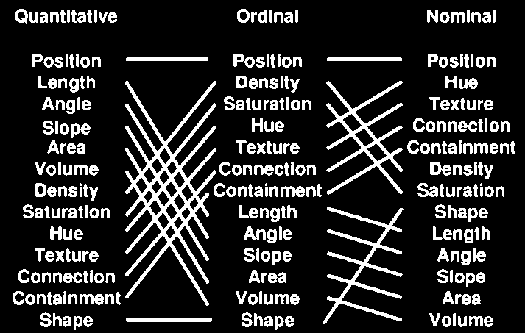
Mackinlay design criteria.
Mackinlay’s list: based on his experiments with computer graphics, trying to automate and formalize the creation of charts
The Vega visual language/grammar is built on Mackinlay’s work
Jock Mackinlay, Tableau/Xerox PARC/Stanford 1986
Notes:
Mackinlay’s list – based on his experiments with computer graphics, trying to automate and formalize the creation of charts
The first charting algorithms. The Vega visual language/grammar is built on Mackilnay’s work.

Slide 17
Which square is lighter?
Notes:
http://web.cse.ohio-state.edu/~machiraju.1/teaching/CSE5544/mackinlay_midterm_material.pdf
Vice President of Visual Analysis at Tableau
https://www.tableau.com/learn/whitepapers/data-storytelling-using-visualization-share-human-impact-numbers

Slide 18
Which square is lighter?
217, 217, 217
> 2 %
212, 212, 212
Notes:
http://web.cse.ohio-state.edu/~machiraju.1/teaching/CSE5544/mackinlay_midterm_material.pdf
Vice President of Visual Analysis at Tableau
https://www.tableau.com/learn/whitepapers/data-storytelling-using-visualization-share-human-impact-numbers

Slide 19
How many times is the right circle larger?
Notes:
http://web.cse.ohio-state.edu/~machiraju.1/teaching/CSE5544/mackinlay_midterm_material.pdf
Vice President of Visual Analysis at Tableau
https://www.tableau.com/learn/whitepapers/data-storytelling-using-visualization-share-human-impact-numbers

Slide 20
How many times is the top bar longer?
7
Notes:
http://web.cse.ohio-state.edu/~machiraju.1/teaching/CSE5544/mackinlay_midterm_material.pdf
Vice President of Visual Analysis at Tableau
https://www.tableau.com/learn/whitepapers/data-storytelling-using-visualization-share-human-impact-numbers

Slide 21
What colour do you see?
Notes:
http://web.cse.ohio-state.edu/~machiraju.1/teaching/CSE5544/mackinlay_midterm_material.pdf
Vice President of Visual Analysis at Tableau
https://www.tableau.com/learn/whitepapers/data-storytelling-using-visualization-share-human-impact-numbers

Slide 22
What colour do you see?
Notes:
http://web.cse.ohio-state.edu/~machiraju.1/teaching/CSE5544/mackinlay_midterm_material.pdf
Vice President of Visual Analysis at Tableau
https://www.tableau.com/learn/whitepapers/data-storytelling-using-visualization-share-human-impact-numbers

Slide 23
What colour do you see?
Notes:
http://web.cse.ohio-state.edu/~machiraju.1/teaching/CSE5544/mackinlay_midterm_material.pdf
Vice President of Visual Analysis at Tableau
https://www.tableau.com/learn/whitepapers/data-storytelling-using-visualization-share-human-impact-numbers

Slide 24

Stevens’ power law.
length
taste
weight
shock
sensation = intensity^{exponent}
Our senses are not linear!
area
volume
loudness
sensation →
intensity →
Stanley Smith Stevens, Harvard, 1957
Notes:
http://web.cse.ohio-state.edu/~machiraju.1/teaching/CSE5544/mackinlay_midterm_material.pdf
Vice President of Visual Analysis at Tableau
https://www.tableau.com/learn/whitepapers/data-storytelling-using-visualization-share-human-impact-numbers

Slide 25
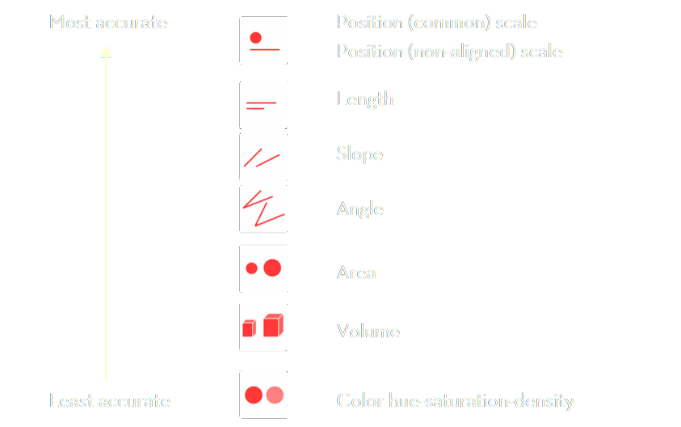
Stevens’ power law.
Stevens’ list: based on psychological experiments with human senses
Stanley Smith Stevens, Harvard, 1957

Slide 26
Visual language is a sign system.
When designing visual information use correct encodings
data → information correct data model
information → knowledge correct visual representation
Bertin’s semiology of graphics
Mackinlay design criteria
Stevens’ power law

Slide 27
Data visualization zoo.
The actual “A Tour through the Visualisation Zoo”
Economics Observatory 🌌 Visualisation Guidelines
Financial Times Visual Vocabulary
Vega Edition of the Visual Vocabulary
The D3 Graph Gallery
Andy Kirks's The Chartmaker Directory
Heer, Bostock, Ogievetsky, A Tour through the Visualization Zoo, ACM, 2010
Notes:
https://homes.cs.washington.edu/~jheer/files/zoo/

Slide 28
Session 4. Visualisation and advanced analytics
Chart types – code-along
[90 min]
[30 min]

